Slide 1
Together Initiative
Together is better than one
A. K. Sabbir Mahbub, Chairman, Devnet Limited
Chairman, BASIS Standing Committee for BPO and ITES
Certified Facilitator Lego SeriousPlay Methods and Materials

Slide 2
Together Initiative
A proposed platform for learning, advising, transforming and growing together

Slide 3
Some of our Major challenges
Weak procurement process (Buyer’s maturity)
Lack of market standards (Buyer’s guide, indexes, budgeting etc.)
Understanding failures (Mistakes → Learning → Management Practices)
Adoption of standard practices (Customer centricity, lean & agile practices, A2i processes, Lean Service Design etc.)
Managing Scope & Project etc.
Product & service maturity
Notes:
by absorbing information from any and all high-fidelity sources (blogs, books, conversations with domain experts, knowledge share with Industry colleagues etc.)
Risk management, change management
Leapfrog from others mistakes
Localization of canvases and templates

Slide 4
What is expected from us?
We need to increase our capacity and capability faster
We need to become more reliable and more process driven
We need to take action for creating space for fair competition with foreign companies
We need to widen adoption of capability and maturity models
We need to introduce and enforce standards
Notes:
Maturity models (Process, product, business etc.)

Slide 5
Can we manage all these challenges and expectations alone
?

Slide 6
We can't do it alone — and we don't have to
Notes:
Failure is part of life, and most certainly part of business. We don't often acknowledge it, but failure is also a fundamental element of our success.
Our instinct is to be ashamed of failure, maybe because we don't like how it makes us feel--humiliated, as though we have done something wrong.
But if you can shift your perspective and look at failure not as something to be ashamed of but something valuable, you can begin to understand that it's through failure that we truly learn to succeed.
The sooner we stop shaming our failures, the easier it will be to turn them to our advantage. Here are seven points to think about:
1. Mistakes are not a problem, but not taking the opportunity to learn from them is. Identify your mistakes and learn from them quickly. Many successful people have experienced some kind of failure--and they build on those lessons. Learning to fail well means learning to understand your mistakes. In every mistake there is a potential for growth.
2. Be careful how you talk to yourself, because you are listening. Self-talk can be incredibly damaging, especially after a failure. Handle your self-talk and don't allow it to make you feel worthless--especially in the aftermath of a failure. Let it sting for a moment, and then do everything you can to stay positive and get back on track.
3. It's far better to do something imperfectly than to do nothing perfectly. The only true failure is doing nothing--inaction puts everything at risk. When we do nothing, it means we are not moving anywhere. And that is a surefire way to stay in failure. All that is required for failure to triumph is for us to do nothing.
4. We are products of our past, but we don't have to let our mistakes define us. Even if the past did not go as we had hoped, our future can still be better than we can envision. Too often, we're afraid to talk about our past and our failures out of fear that they'll define us. Let it out, but stay focused on what's ahead.
5. The enemy of success is fear of failure. It's not failure itself that's so dangerous--it's the fear of failure that keeps us doing nothing. Like all fears, you conquer it by facing it down. And when the fear of doing nothing exceeds the fear of doing it wrong, that is when your true work begins.
6. Consistent action creates consistent results. Strength doesn't come from what you can do, it comes from mastering the things you once thought you couldn't do. So let yourself fall down, but learn to dust yourself off and get up and move forward. What you do every day matters more than what you do every once in a while. Consistency is key to success.
7. You can't do it alone--and you don't have to. Sometimes our failures keep us stuck in our old ways and we need support to help us get past our bad habits. The worst thing we can do is think we need to handle this alone. Find a coach, a mentor, or a friend who supports you in your efforts and has the experience to get you pointed toward your own success.

Slide 7
Collectively we have all the knowledge that is required for us to meet our challenges
Notes:
“The best way to overcome a mistake is to learn from it and put systems in place not to repeat it. Sure failure is educational, and even necessary in many ways, but that doesn’t mean you want to repeat the same mistake over and over.”
We are products of our past, but we don't have to let our mistakes define us. Even if the past did not go as we had hoped, our future can still be better than we can envision. Too often, we're afraid to talk about our past and our failures out of fear that they'll define us. Let it out, but stay focused on what's ahead.

Slide 8
What we can achieve collectively?
Can learn (failures and successes) from each other and leapfrog
Can get the best out of our efforts
Can make our transformation easier
Can build trust, respect and promote each other
Can think and do things differently

Slide 9
We are products of our past, but we don't have to let our mistakes define us.
Even if the past did not go as we had hoped, our future can still be better than we can envision.
Notes:
Too often, we're afraid to talk about our past and our failures out of fear that they'll define us. Let it out, but stay focused on what's ahead.

Slide 10
"Life is too short to learn from your own mistakes, so learn from other people's mistakes
Notes:
"Life is too short to learn from your own mistakes, so learn from other people's mistakes by absorbing information from any and all high-fidelity sources (blogs, books, conversations with domain experts).
Some companies have a culture of ‘don't come to your boss with problems, come with solutions.’ It's actually horrible advice. Yes, you want smart competent problem solvers on your team, but you also want an open team dynamic where people are working together with honest open lines of communication, not a culture of fear and perfection."

Slide 11
Our objective
Creative exploration, careful consideration, and seeking common ground to create a shared platform and common body of knowledge with local language and thinking.
Build or enhance community capacity – to work together, to reach agreements, to help make great places, to care for one another and care for the organizations created and share the pride.
An resource sharing platform (HR, Infrastructure, technology & tools, product and services).
Build awareness on grow together.
Empower buyer’s (Develop buyer’s guide, change behavior etc.)
Notes:
Develop/adopt and improve agreed frameworks, practices, business models and processes.
Learn from each other through shared knowledge, tool kits, experience and proven practices
Build and publish case studies (Successful projects and lessons learned)
Deep drive on common challenges

Slide 12
Evaluate specific products/services: becomes willing to engage with sellers and prepares procurement methodology
Commits to a specific solution or service provider through a specific procurement process. QCBS, BOT, DPM etc.
Expects good product/service performance and great customer service; may become an advocate
Gets interested in finding a solution, begins to discover what can be done
May become interested in expending use of goods and services
Awareness
Interest
Consideration
Procurement
Post Purchase
Re-purchase
Becomes aware of pains
BUYERS
FOCUS ON PROBLEM
FOCUS ON SOLUTION
SHOW WHAT IT LIKE TO WORK WITH THE INDUSTRY
VALIDATE THEIR DECISION
CONTINIOUS LEARNING
STAY IN TOUCH
US
Focus on problem and pain points. Use of big picture and industry focused content. Entertain with best practices, case studies etc.
Focus on service/ solutions Educate, strategize procurement process, Project design, solution design, help building buying criteria, white papers, eBooks etc.
DEMOS, data sheets, Procurement documents, ToR Preparation, Budgeting, SLA preparation, Finalize procurement process
Make the contract process easy. Begin product/service delivery, implementation, Training/service phase. Kick off events.
Continuous learning, feed backs, value analysis, introduce new features, Optimize, maintenance services etc. Make them feel cared for.
Look for opportunities to upgrade or expand product use. Up sales and cross sales is also possible.

Slide 13
Become aware of the paints
Organizational inefficiencies
Client Services
Compliances
BUYERS
Awareness
FOCUS ON SOLUTION
Focus on problem
Value Proposition
Success/failure criteria
Create big picture
Best practices
Case studies
Connect with community
BASIS

Slide 14
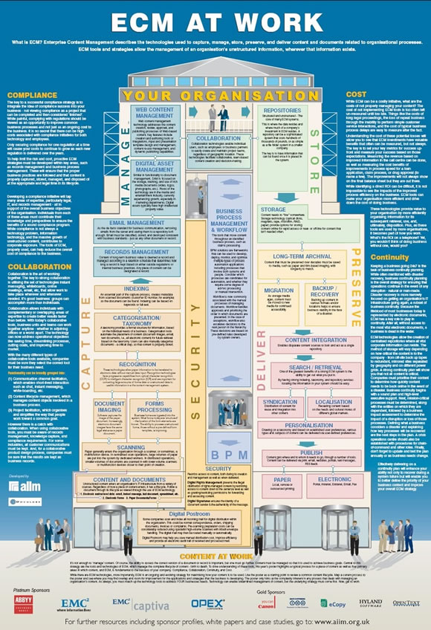
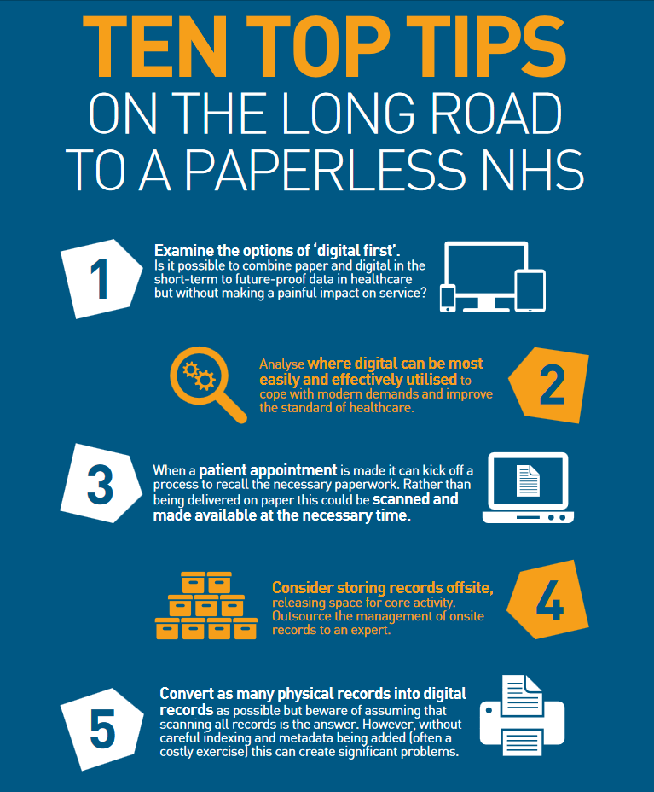
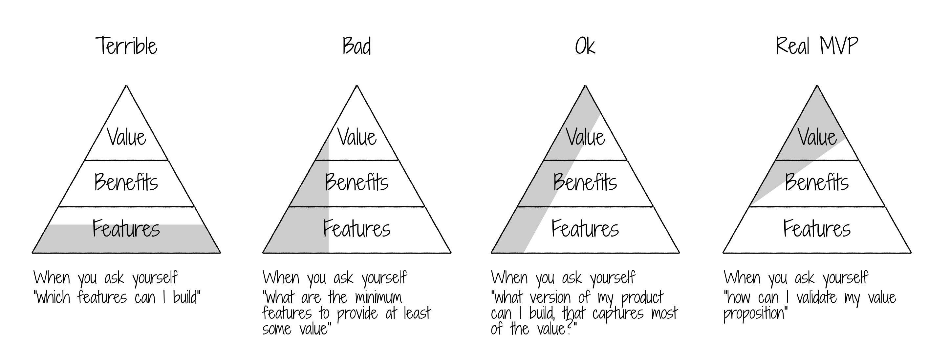
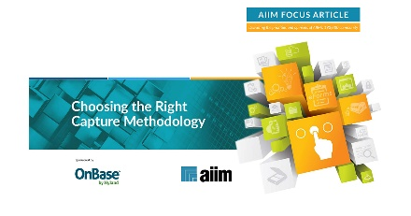
Discover what can be done
Social media
Web search
Market place
Community
Gets interested in finding a solution, begins to discover what can be done
BUYERS
Interest
FOCUS ON PROBLEM
Educate
Buyer’s Guide
White Paper
Strategize procurement process
OTM
BOT
Pre-sales/Consulting
Solution Design
Project design
DPM
eBooks
Product Design
BASIS
Focus on service/ solutions Educate, strategize procurement process, Project design, solution design, help building buying criteria, white papers, eBooks etc.

Slide 15
Evaluate specific products/services: becomes willing to engage with sellers and prepares procurement methodology
Evaluate
Procurement methodology
Solutions
Who can be the right partner
Planning
Budget
Solution
Project
Capability & Maturity Model
BUYERS
Standard SLA Formats
Consideration
Clients Awareness on SDLC
Consideration
Demos
Solutions
User Visits
Procurement Process
Tender Document
Partner visits
ToR
Budgeting
Partner requirements
Capability
SLA’s
Success & Failure Criteria
BASIS
ToR
DEMOS, data sheets, Procurement documents, ToR Preparation, Budgeting, SLA preparation, Finalize procurement process
Budgeting

Slide 16
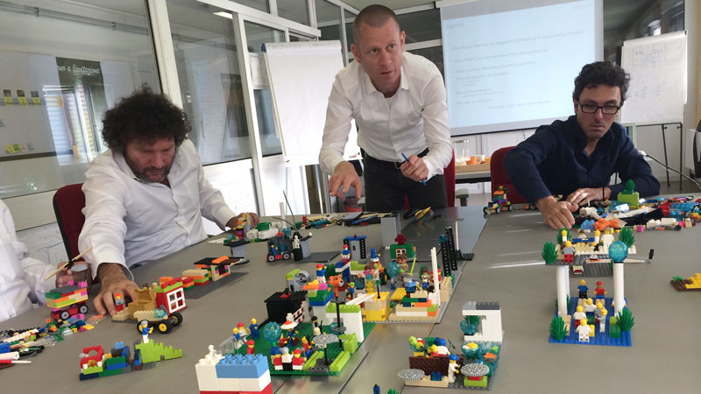
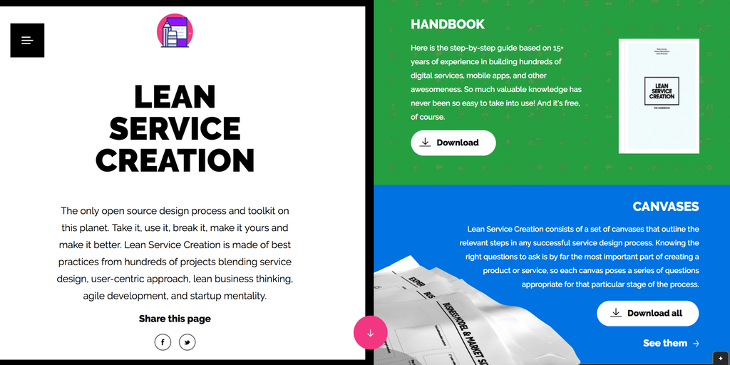
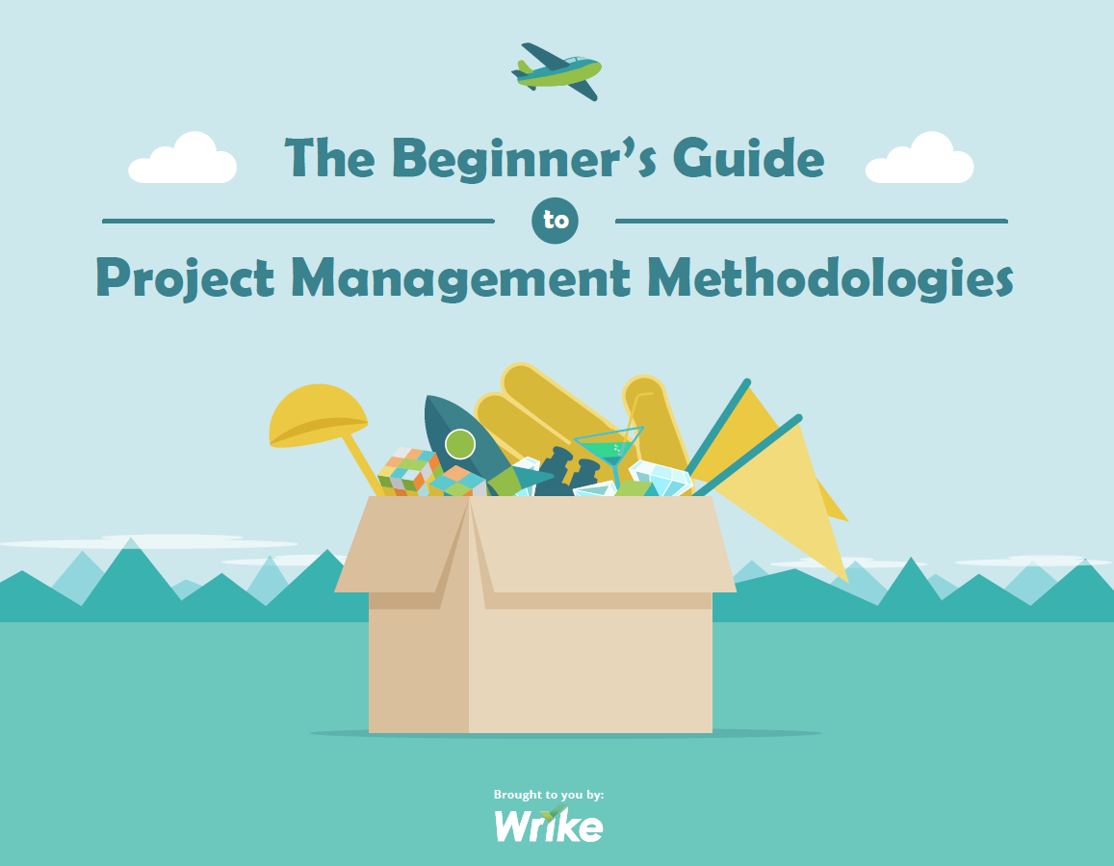
Monitor
Values
SLA’s
Risks
Commits to a specific solution or service provider through a specific procurement process. QCBS, BOT, DPM etc.
BUYERS
Procurement
VALIDATE THEIR DECISION
Scope Management
Lean Initiation
Lean Service Creation
Processes
Change Management
Negotiation
Project Management
Documentations
BRD & SRS
Knowledge Management
Test cases
Risk Management
MVP/MLP
Conflict Management
Communication Management
Concepts that might assist
BASIS
Make the contract process easy. Begin product/service delivery, implementation, Training/service phase. Kick off events.
Notes:
Meeting Management

Slide 17
Performance
Customer Service
Values
Future
Become an advocate
Customer references
Case study
Testimonials
Expects good product/service performance and great customer service; may become an advocate
BUYERS
Post Purchase
CONTINIOUS LEARNING
Continuous Learning
Domain
After sales
Optimize
Grow
New futures
Feature enhancement
Change Management
Maintenance
Manage SLA
BASIS
Continuous learning, feed backs, value analysis, introduce new features, Optimize, maintenance services etc. Make them feel cared for.
Notes:
Meeting Management

Slide 18
Expending
Services
Goods
May become interested in expending use of goods and services
BUYERS
Re-purchase
STAY IN TOUCH
Opportunities
Up-sale
Upgrade
Cross-sale
BASIS
Look for opportunities to upgrade or expand product use. Up sales and cross sales is also possible.
Notes:
Meeting Management

Slide 19
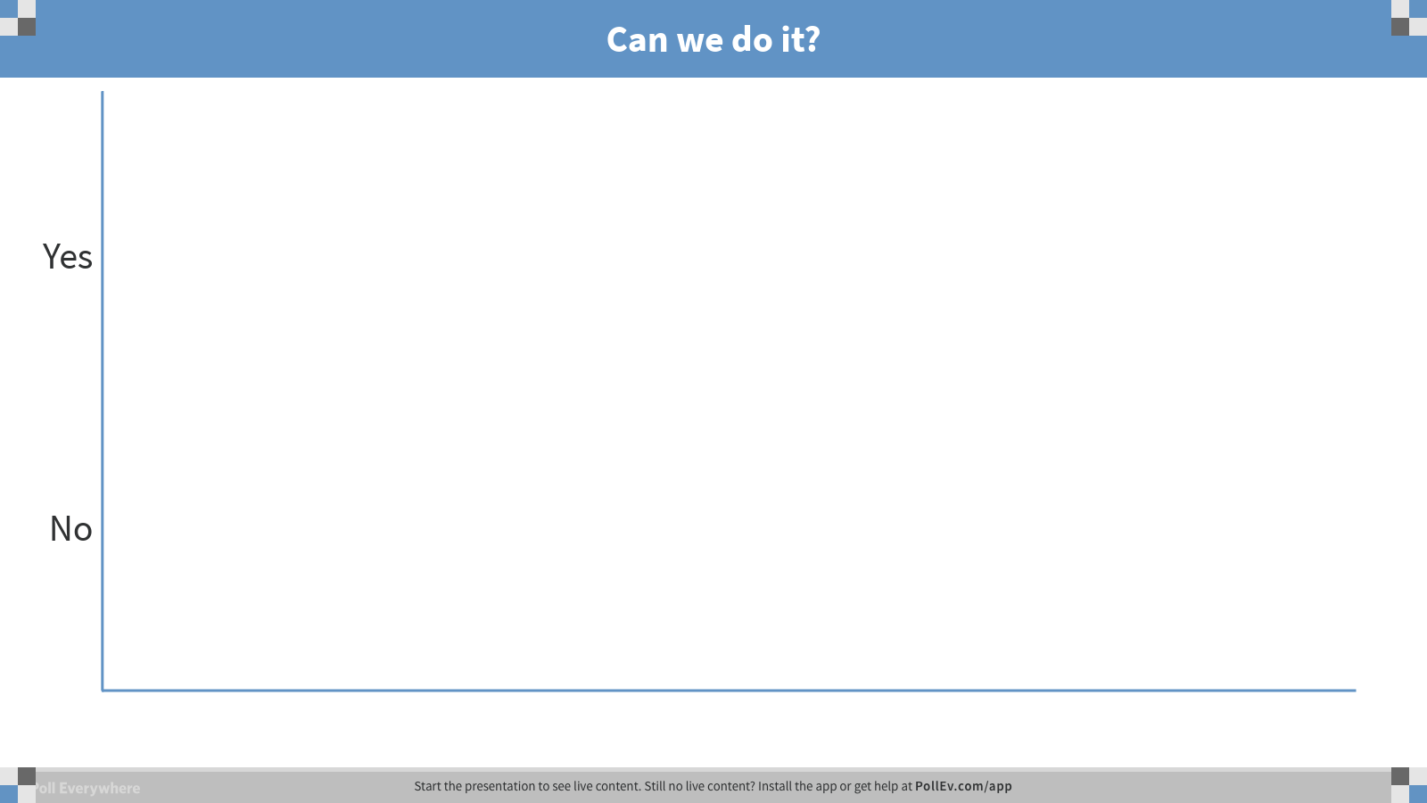
Notes:
Poll Title: Can we do it? https://www.polleverywhere.com/multiple_choice_polls/wflMt3GtCmNL0nl

Slide 20
It's far better to do something imperfectly than to do nothing perfectly

Slide 21
Create common body of knowledge
Learn from each other through shared knowledge, toolkits, experiences and proven practices
Build and publish case studies (Successful projects and lessons learned)
Deep drive on common challenges(Scope management, budgeting, quality matrix etc.)
Adopting/developing standards and maturity models
Building templates (BRD, SRS, PM, case study etc.)
Standard Proposal Formats (DPP, TPP, ToR etc.)
Analyze, localize and adopt international best processes (Lean Service Creation, Value proposition, Minimum Viable Product (MVP) etc.)

Slide 22
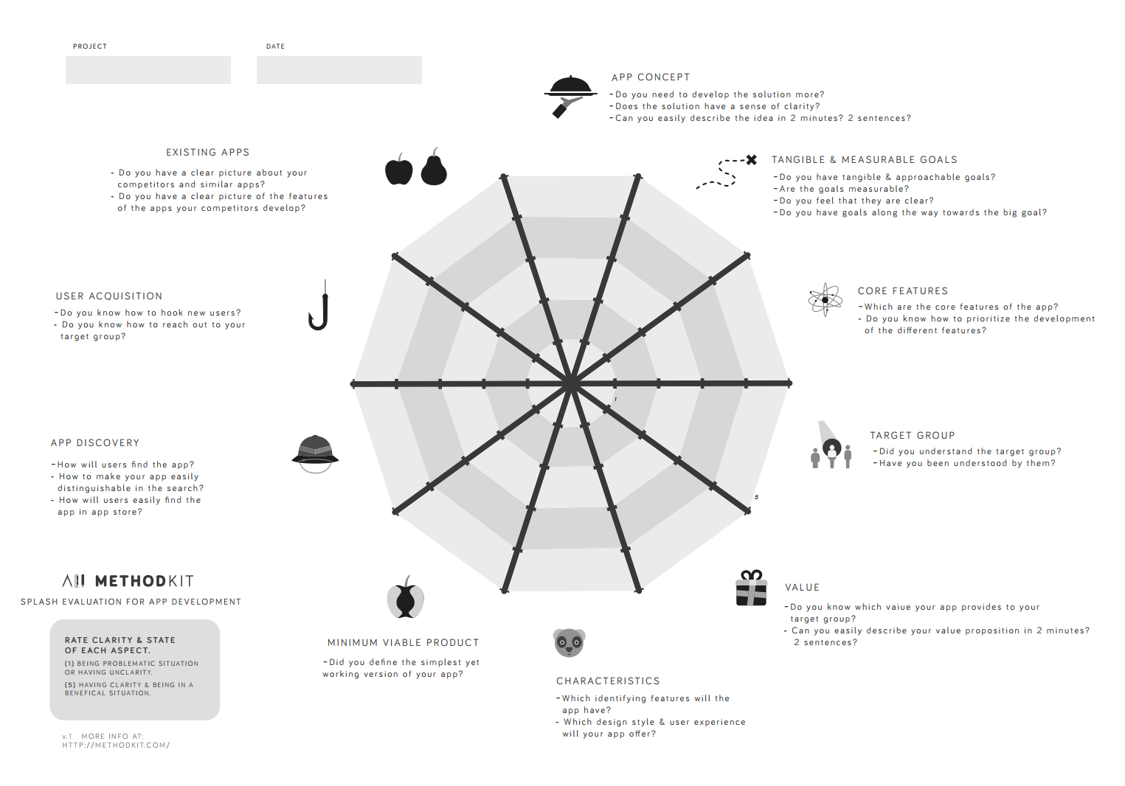
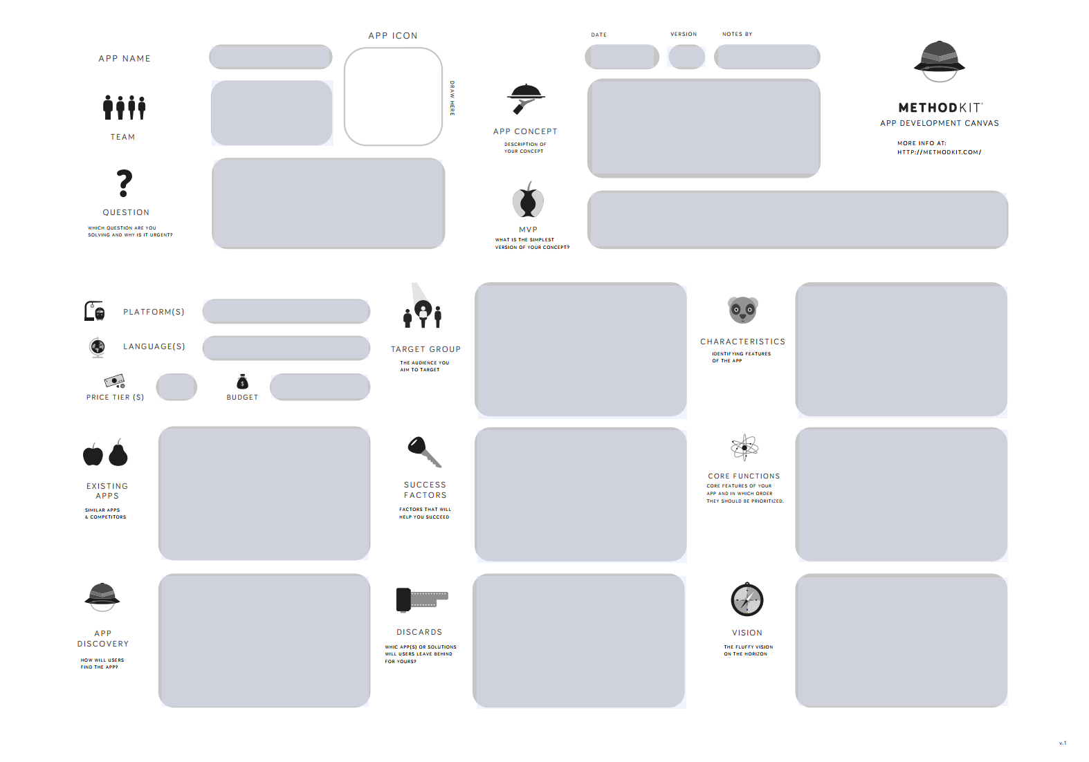
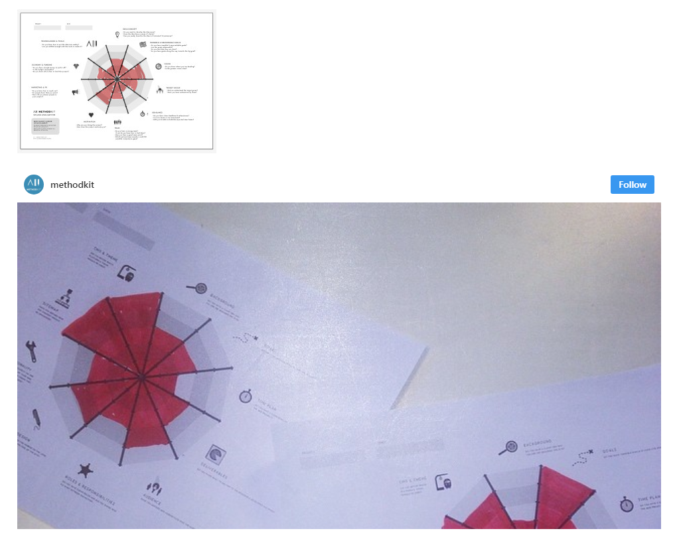
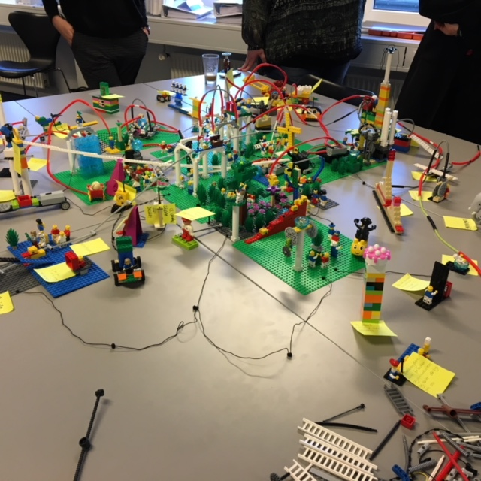
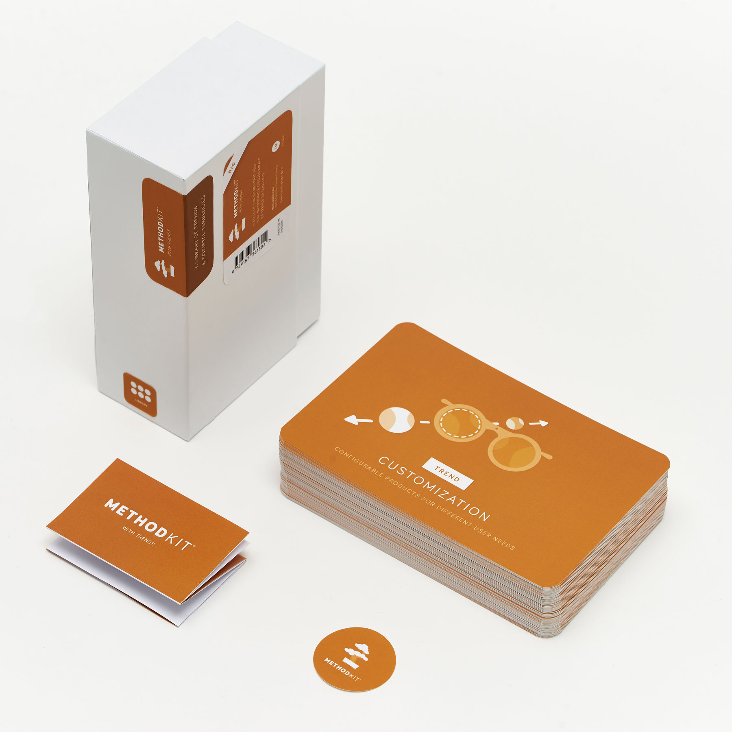
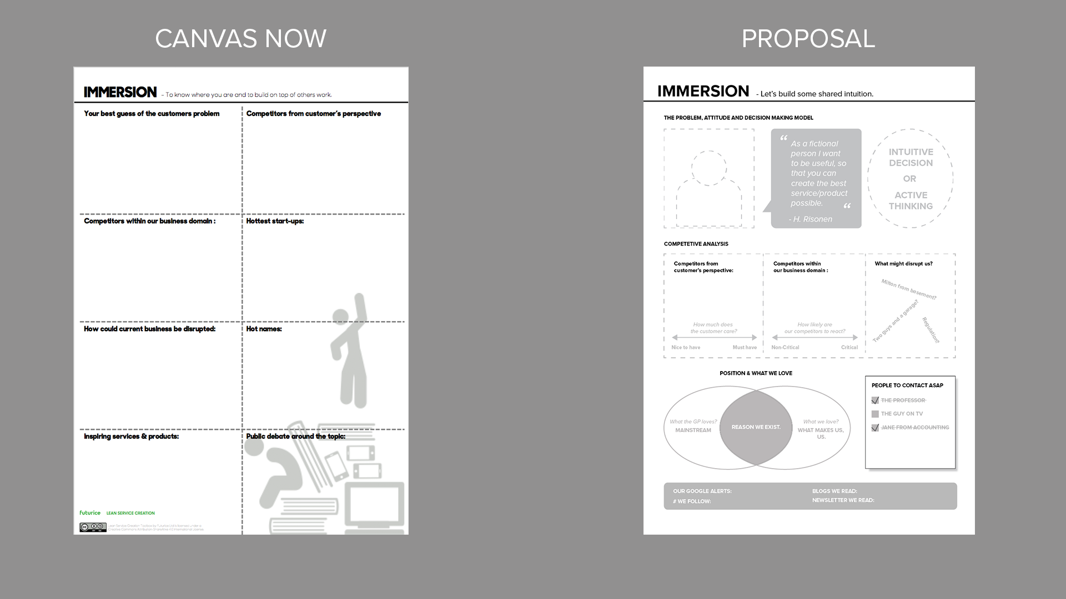
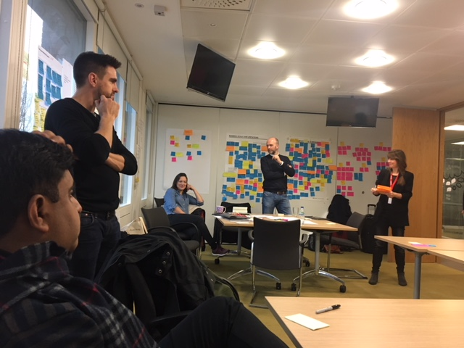

Test and localize best practices and templates
Lean Service Creation
Platform innovation kit
Project Management for small service companies
Scope management (LSC, Lego Serious Play etc.)
Method Kits
Budgeting
Unlearn, learn and building new culture etc.

Slide 23
Test and localize best practices and templates
Lean Service Creation
Platform innovation kit
Project Management for small service companies
Scope management (LSC, Lego Serious Play etc.)
Method Kits
Budgeting
Unlearn, learn and building new culture etc.

Slide 24
Learn from each other
Customer Journey Mapping
Process Design & Modeling (BPMN 2.0)
Facilitating in the improvement of soft skills (Communications, meeting management, negotiations, conflict management, communication, story telling, leaderships etc.)
Minimum Viable Product (MVP)
Buyer’s guide and case studies
Standards and framework development (CCDS, Interoperability framework, eGov Architectures etc.)
Being Agile

Slide 25
Simple guiding principles
Appreciate different interests – and respect everyone
Engage all stakeholder groups
Incorporate variety of ways to participate
Incorporate variety of ways to participate
Engage all stakeholder groups
Room for lots of parallel activity – but plan for connections too
Love the problem not the solution
Appreciate different interests
– and respect everyone
Evolve with needs and change and improve continuously
Welcome new comers as well as familiar faces
We are here to build agreed models
We are here to build agreed models
Love the problem not the solution
Welcome new comers as well as familiar faces
Room for lots of parallel activity – but plan for connections too
Evolve with needs and change and improve continuously
Notes:
"Own it. Let go of the pride that doesn't want you to admit that you're wrong. And don't waste time letting the guilt or shame consume you. Use that time to come up with a solid action plan to fix it (or at least reduce the negative impacts of your actions) in conjunction with a plan on how you can avoid such a problem in the future.”

Slide 26
Culture we will embrace
Ask why
We love feedback
Hate the process not the people
Honest and transparent
Respect & Confidentiality
Share freely our failures
Continuous improvement
Agility

Slide 27
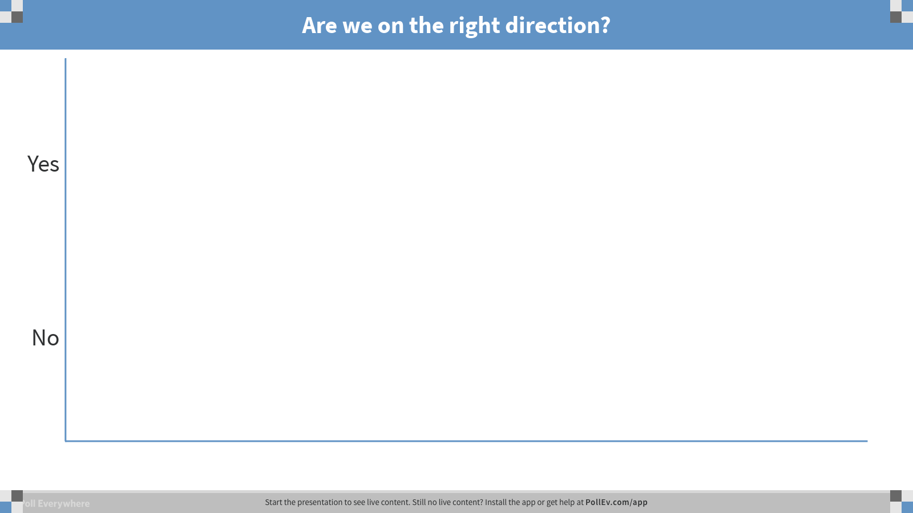
Notes:
Poll Title: Are we on the right direction? https://www.polleverywhere.com/multiple_choice_polls/panIygazhpYooJZ

Slide 28
Decision making
When moving towards a decision/policy, there will be three (3) times two (2) aspects to consider about its immediate and future impact:
How does the decision/policy affect your colleagues, the customer and the numbers, now and in the future.
Colleagues
Now
Customers
Future
Numbers

Slide 29
Members
Contributing members (Those who are contributing)
Qualifications: An individual or an organization who actively participates in the process analyzing, advising and developing.
Benefits: Credential is given by name and opportunity is given to his/her respective organization to insert logo and intro within the publication.
User groups
Who want to be a part of the process only for observing the continuous improvement
Who wants to try the knowledge and give feedback to the development process

Slide 30
Operating Framework
Working groups & Editorials
Each team member within the working group will be responsible to specific roles
Each working group will have a adopted process of working

Slide 31

Join us in Sharing & Shinning

Slide 32
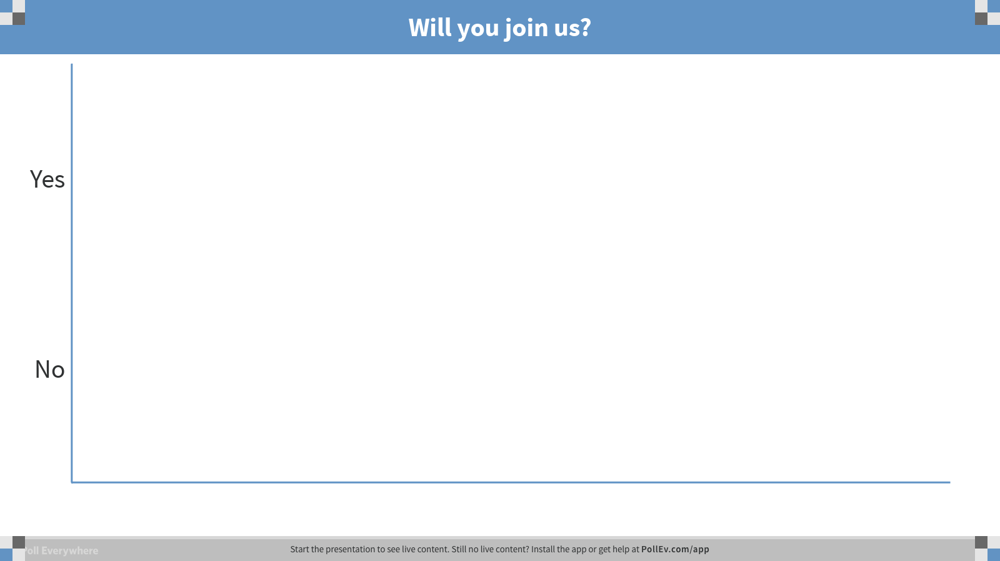
Notes:
Poll Title: Will you join us? https://www.polleverywhere.com/multiple_choice_polls/0mX7xn75lbPP9IB

Slide 33
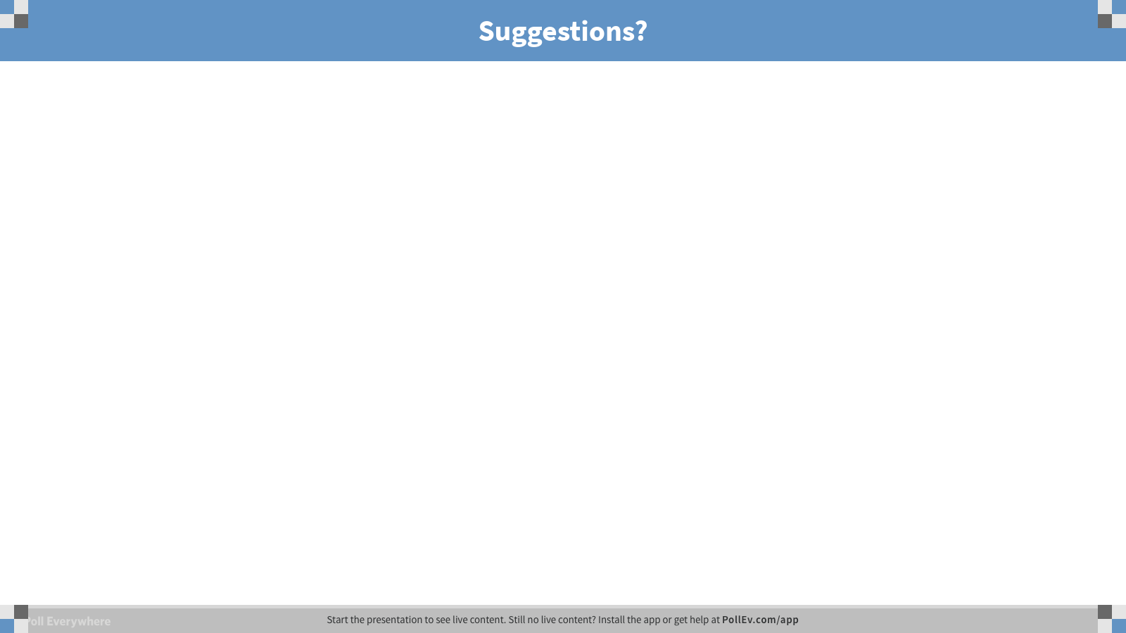
Notes:
Poll Title: Suggestions? https://www.polleverywhere.com/free_text_polls/5SZOSjn4RwbYZJ1

